Slide 1

Social aspects of sustainable development

Slide 2

Plan:
Wealth and poverty
Against poverty and prevent social stratification
Personal and family health
Human rights
The social welfare system
Improvement of the nation (Health)
Promoting a healthy lifestyle
Ecological education
Formation of ecological culture

Slide 3
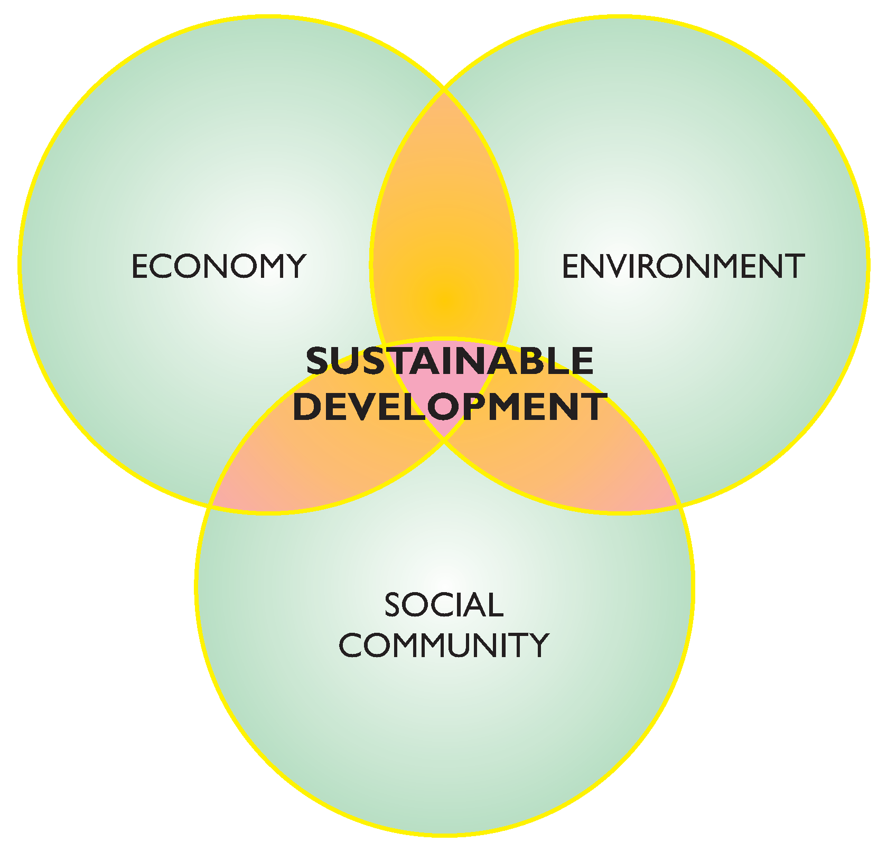


Slide 4


Social sustainability
Social sustainability is one aspect of sustainability or sustainable development. Social sustainability encompasses human rights, labor rights, education, health and corporate governance.

Slide 5

Human rights
Human rights are moral principles or norms that describe certain standards of human behavior, and are regularly protected as legal rights in municipal and international law.

Slide 6

Environmental rights of human :
1. The right to a healthy environment.
The right to accurate information about the state of the environment.
The right to compensation for damage caused to health or property by an environmental offense.

Slide 7



Wealth and poverty

Slide 8
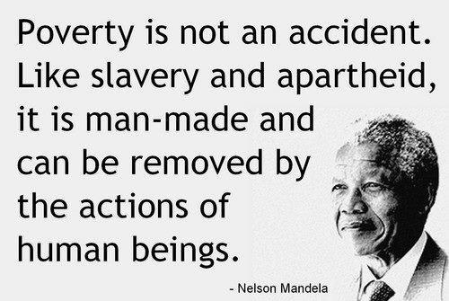
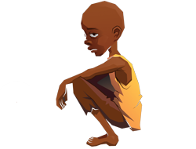
Against poverty and prevent social stratification
The problem of combating poverty is multifaceted and multipart. Its solution lies in the plane of economics, politics, law, culture, education, medicine.

Slide 9


Against poverty and prevent social stratification
The most important priorities in the fight against poverty in modern Kazakhstan are:
1- is the creation of conditions for self-normal levels of well-being of all families with able-bodied adults to work through; 2 - formation of effective support for vulnerable groups (the elderly, people with disabilities, families with a high dependency burden, families in extreme situations) and guarantees of non-discriminatory access to free resources.

Slide 10

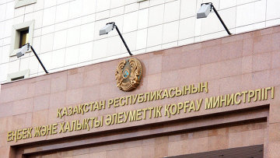
The social welfare system
Based on the analysis of international experience, we can conclude that the most effective and comprehensive system of social protection typically include the following basic elements: - State benefits; - Compulsory social insurance; - Cumulative pension; - Social assistance.

Slide 11

Improvement health of nation
The Strategy "Kazakhstan-2050" the basis for successful future of the country is named the nation's health, and one of the main ways to strengthen it - a radical improvement of medical education.
Kazahstan 2050

Slide 12
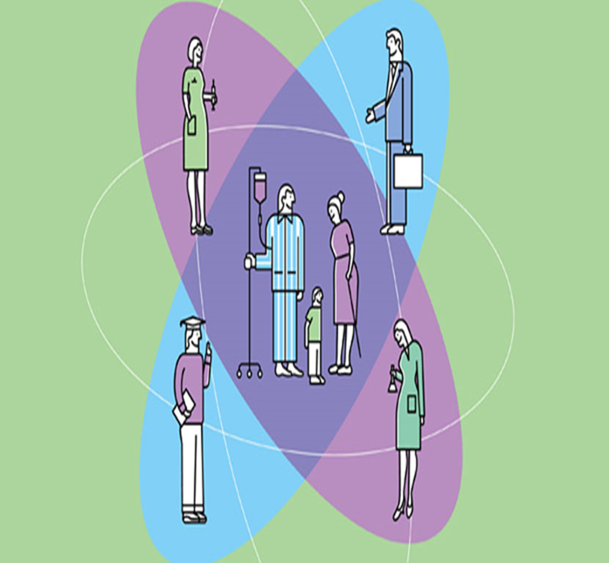

Improvement health of nation
- Ensure the provision of high-quality and affordable health care; - To provide diagnosis and treatment of the widest possible range of diseases;

Slide 13


Promoting healthy lifestyle
Healthy lifestyle - the image of a person's life, the promotion of health. The adoption of preventive measures to address the causes and consequences of the disease.

Slide 14

Promoting healthy lifestyles is a challenge for many primary care practices. However most patients understand the importance of physical activity and healthy eating, many seem unable to change their unhealthy behaviors to reduce weight and improve chronic conditions.

Slide 15


Maintain your ideal body weight
Cancers of the uterus, gallbladder, kidney, stomach, breast, and colon have been associated with obesity.

Slide 16



Vary your daily diet
Eat in moderation with a wide variety
of food choices.

Slide 17

Health & Wellness
Unhealthy lifestyles attribute 54% reduction in lifespan < 65 years
Healthy lifestyles have greater impact than genetic factors on our health as we age
Wellness = product of healthy lifestyles as fitness = product of regular exercise
Physical well-being includes, mental, and health aspects of life

Slide 18

Environmental Education (EE) is the teaching of individuals, and communities about environment and its associated problems, aware of the solutions to these problems, and motivated to solve them.
Environmental education

Slide 19
Goals of Environmental Education
To improve the quality of environment;
To create an awareness among the people on environmental problems and conversation;
To create an atmosphere so that people participate in decision – environmental problems;

Slide 20

Ecological education
Today is particularly relevant role of environmental education as the basis of a new morality and support, to address the many issues of practical life.

Slide 21


education
Environmental education should be developed in early childhood, so it is very important that at this age with the child was a smart, competent instructor, able to develop in him the beginning of ecological culture

Slide 22


Higher education in sustainability across education streams including engineering, finance, supply chain and operations is gaining weight-age.

Slide 23

Formation of ecological culture
Ecological culture — a relatively new problem that is acute due to the fact that mankind has come very close to the global environmental crisis

Slide 24

Formation of ecological culture shall be directed at formation of an active public position in both defending public's vested rights for favorable environment.

Slide 25



Conclusion:
In conclusion, as we can see , our nature is so polluted today.
The reason of that is people haven’t got from early ages a good teacher to form a ecological view of a child. As the matter of fact the main problem of each government is the population size and environmental ecology, so I think to make our ecology future better we should track ourselves and think about future generations. Finally, don’t be lazy and do at least 1 or 2 things that can improve our health and environment.

Slide 26
http://www.hazon.org/wp-content/uploads/2012/08/Human-rights-and-ecology2013.pdf
http://unac.org/wp-content/uploads/2013/07/HRandSD-EN-PDF.pdf
https://clas-pages.uncc.edu/inss/what-is-social-sustainability/
https://en.wikipedia.org/wiki/Social_stratification
http://2012books.lardbucket.org/books/sociology-brief-edition-v1.0/s09-social-stratification.html
https://www.google.ru/search?q=social+welfare+programs+definition&newwindow=1&biw=1014&bih=609&source=lnms&tbm=isch&sa=X&ved=0CAYQ_AUoAWoVChMI3pu1joewyAIVgc0aCh3qoQJl#imgrc=kZu7l7wXK0S8XM%3A
https://my.clevelandclinic.org/health/diseases_conditions/hic_Cancer_Overview/hic_Promoting_a_Healthy_Lifestyle_with_Diet_and_Nutrition_to_Prevent_Cancer

